Slide 1
Okay, here is a detailed briefing document summarising the main themes and important ideas from the provided source about Recurrent Neural Networks (RNNs).
Briefing Document: Introduction to Recurrent Neural Networks (RNNs)
Source: Excerpts from "Why RNNs are needed | RNNs Vs ANNs | RNN Part 1" (Video Transcript)
Date: 25 October 2023
Subject: Overview and necessity of Recurrent Neural Networks (RNNs) for handling sequential data compared to Artificial Neural Networks (ANNs) and Convolutional Neural Networks (CNNs).
Summary: This video introduces Recurrent Neural Networks (RNNs) as a special class of neural networks designed specifically for handling sequential data, in contrast to Artificial Neural Networks (ANNs) for tabular data and Convolutional Neural Networks (CNNs) for grid-like data (images, video). The primary focus is on explaining why RNNs are necessary, highlighting the limitations of ANNs and CNNs when dealing with data where the order or sequence of elements is crucial for understanding its meaning. The video provides several real-world examples of sequential data and RNN applications, concluding with a roadmap for future videos covering RNN architecture, training, problems, and advanced concepts.
Main Themes and Important Ideas:
Introduction to RNNs as Sequential Models:
RNNs are presented as the third major type of neural network discussed, following ANNs and CNNs.
They are explicitly defined as a "special type of sequential model specifically designed to work on sequential data."
Their primary application area is for tasks involving sequences, particularly in Natural Language Processing (NLP).
Defining Sequential Data:
Sequential data is data where the "sequence matters."
Examples provided include:
Text: Sentences where the order of words is crucial for meaning (e.g., "Hey my name is Nitish").
Time Series Data: Graphs showing data points over time, where past values influence future values (e.g., stock prices over years).
Audio: Waveforms representing sound, which are inherently sequential.
DNA Sequences: Biological data with a specific ordered structure.
This contrasts with "non-sequential data" like tabular data (e.g., predicting placement based on CGPA, marks, gender) where the order of features does not matter.
Limitations of ANNs for Sequential Data:
The core problem with using ANNs for sequential data, particularly text, is their inability to handle inputs of varying sizes.
When representing text using methods like one-hot encoding, sentences with different numbers of words result in input vectors of different lengths.
Traditional ANNs require a fixed input layer size.
While "zero padding" (adding zero vectors to shorter sequences) can be used as a workaround, it is described as a "जुगाड़ू solution" (makeshift solution) that leads to:
"A lot of unnecessary computation" due to the padded zeros.
Potential problems during prediction if encountering inputs longer than the maximum length used for padding during training.
The most significant limitation is that ANNs "totally disregard the sequence information."
Since all words in a sequence are typically fed into an ANN simultaneously, "any word that came first and any word that came later... this information is lost."
ANNs lack the "capability to have memory," meaning they cannot retain information about previous elements in the sequence.
This loss of sequence information prevents ANNs from capturing the "semantic meaning," the "hidden meaning," within the text.
Consequently, ANNs are not well-suited for tasks where understanding context derived from sequence is essential, leading to "accuracy" not being "that good."
The Necessity of RNNs:
"That is why RNNs are needed."
Since ANNs cannot effectively handle sequence-based data and retain memory of past elements, there was a need to "create an entirely new architecture that specifically works for sequence-based data."
Applications of RNNs:
RNNs are widely used in "NLP related areas."
Several "interesting application use cases" are demonstrated:
Sentiment Analysis: Determining if text has a positive or negative sentiment ("giving you the state of art results"). Example shown with a movie review.
Sentence Completion: Predicting the next word or phrase in a sentence (seen in Gmail, phone keyboards). Example shown with Gmail suggesting "I hope you are doing well."
Image Caption Generator: Generating a textual description for an image. Example shown generating a caption for an image from the show Mirzapur and discussing potential use cases for visually impaired individuals.
Machine Translation: Converting text from one language to another (e.g., Google Translate). Example shown translating "और भाई क्या हाल है" from Hindi to English, highlighting both language detection (also an RNN application) and translation.
Question Answering Systems: Although more advanced models like BERT (derived from basic RNN concepts) are mentioned, the principle of processing text to answer questions is highlighted. Example shown querying a Wikipedia paragraph about Tesla.
Other applications briefly mentioned include Time Series Forecasting and Speech Classification.
Future Roadmap:
The next videos will delve deeper into RNNs.
Planned topics include:
Simple RNN architecture and implementation (using Keras).
Backpropagation in Time (the RNN training algorithm).
Problems in RNNs (Vanishing Gradient, Exploding Gradient) and solutions.
Advanced architectures like LSTMs (Long Short-Term Memory) and GRUs (Gated Recurrent Units).
Types of RNN architectures (likely referring to sequence-to-sequence, many-to-one, etc.).
Deep RNNs (stacking multiple RNN layers).
Bidirectional RNNs.
The approach will combine theoretical explanations, coding examples, and small projects.
Key Takeaways:
Sequential data is common and requires specialized models.
ANNs are fundamentally ill-equipped to handle sequential data due to fixed input size and, crucially, the lack of memory to process information in order.
RNNs were developed specifically to address these limitations by incorporating mechanisms to process sequences element by element and maintain a "memory" of previous elements.
RNNs power many modern applications in NLP and beyond, demonstrating their significant impact.
Understanding the "why" behind RNNs' existence is crucial before diving into their architecture and training.
This briefing document provides a concise overview of the video's content, highlighting the core argument for using RNNs and outlining the path forward for learning more about this important class of neural networks.

Slide 2
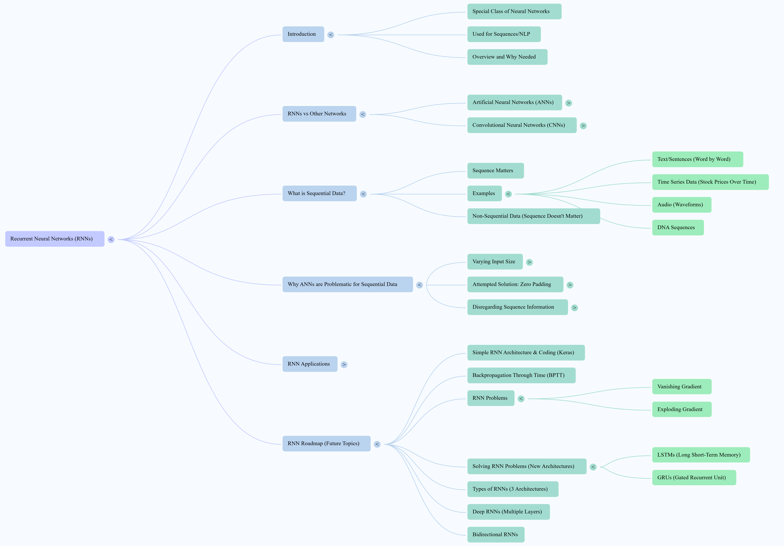

Slide 3
Here are notes based on the provided sources regarding Recurrent Neural Networks (RNNs):
Recurrent Neural Networks (RNNs) are a special class of neural networks specifically designed to work on sequential data.
They are a type of sequential model.
RNNs are very useful for sequences or NLP (Natural Language Processing) related tasks.
RNNs are the third type of neural network discussed in the course, following Artificial Neural Networks (ANNs) and Convolutional Neural Networks (CNNs).
Comparison with other Neural Networks:
Artificial Neural Networks (ANNs) are generally applied to tabular data.
Convolutional Neural Networks (CNNs) are used for grid-like data, such as images or videos.
RNNs are a class of neural networks that perform very well in NLP-related areas.
Sequential Data:
RNNs work on sequential data, where sequence matters.
Examples of sequential data include:
Textual data, where words come after each other sequentially and the sequence matters for understanding the meaning.
Time series data, such as graphs showing changes over time (e.g., stock prices), where past data depends on future trends.
Audio data, like spoken language, which can be represented as a waveform and is sequential.
DNA sequences.
The sources state that a lot of sequential data exists in the world.

Slide 4
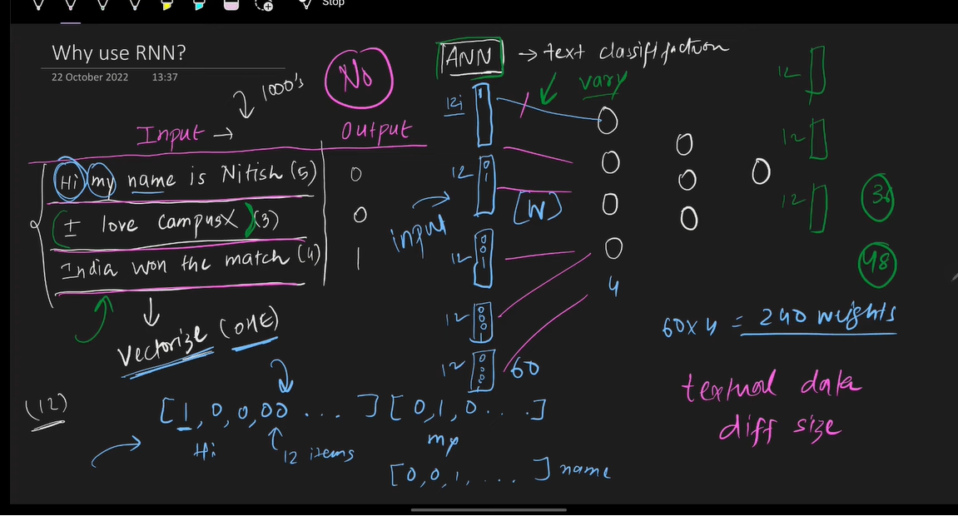
Problems with using ANNs for Sequential Data:
Using ANNs on sequential data presents several significant problems.
Input must be vectorised: First, text data needs to be converted into a numerical representation, such as using One-Hot Encoding, TF-IDF, or Word2Vec. One-Hot Encoding is a simple representation where each unique word in the vocabulary is given a unique vector.
Varying Input Size: A major problem is that sentences have varying numbers of words, leading to different input sizes for the ANN. Standard ANNs require a fixed input size. This prevents the input layer from being properly formed if input sizes vary.
"Jugaad" (Makeshift) Solution - Zero Padding: A makeshift solution is to use zero padding, where shorter sequences are padded with vectors of zeros to match the length of the longest sequence.
Problems with Zero Padding:
This is a "jugaadhu" (makeshift) solution.
It leads to a lot of unnecessary computation and an increase in the number of weights, especially with large vocabularies and long sequences. For example, with a vocabulary of 10,000 words and maximum sequence length of 100, the input size could be 10 lakh, resulting in a large number of weights.
It can still cause problems during prediction if a new input sequence is longer than the maximum length used for training.
Losing Sequence Information: The most significant problem is that ANNs totally disregard the sequence information. When words from a sentence are fed into an ANN simultaneously, the information about which word came first or later is lost.
Loss of Semantic Meaning: This loss of sequence information means the ANN loses the semantic meaning or hidden meaning within the text that arises from the order of words.
Lack of Memory: ANNs are not designed to have memory; they cannot retain information about what came before or after.
Due to these issues, using ANNs on sequential data results in poor accuracy because they cannot capture the semantic meaning based on sequence.
Why RNNs are Needed:
Because ANNs cannot handle sequential data effectively (due to varying input size, unnecessary computation with padding, and inability to retain sequence information or semantic meaning), there was a need to create an entirely new architecture specifically for sequence-based data. This is why RNNs are needed.

Slide 5
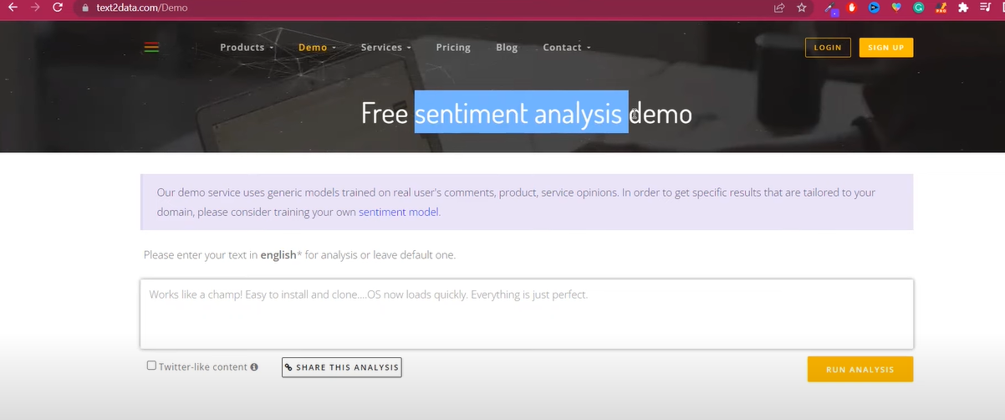
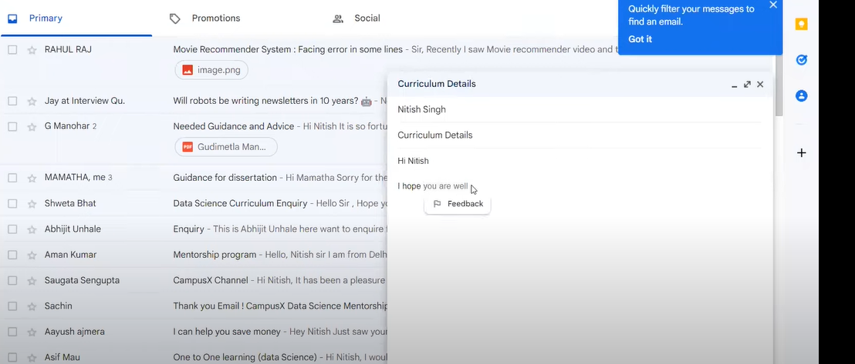
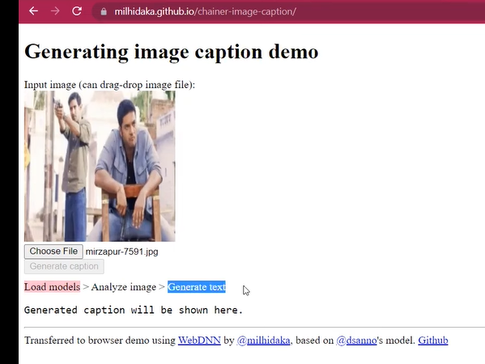

Applications of RNNs:
RNNs have many interesting application use cases and have brought about a revolution in handling sequential problems.
Some interesting applications mentioned include:
Sentiment Analysis: Analysing text (like movie reviews) to determine if the sentiment is positive or negative. This is used by companies (e.g., Flipkart) to analyse customer reviews.
Sentence Completion: Predicting the rest of a sentence being typed, seen in applications like Gmail.
Next Word Prediction: Predicting the next word, commonly used in phone keypads.
Image Caption Generator: Generating a textual description (caption) for an image. This can be useful for applications assisting visually impaired individuals.
Machine Translation (like Google Translate): Translating text from one language to another. This often involves automatic language detection and then translation.
Question Answering Systems: Given a paragraph of text, answering questions related to that text. While modern systems like BERT, which derive basics from RNNs, are used, the core idea is related. This has potential uses in fields like medicine or summarizing web content.
Time Series Forecasting.
Speech Classification.
Roadmap for Learning about RNNs:
The source outlines a plan for future videos to delve deeper into RNNs:
Study the simple RNN architecture and its implementation using Keras, with small examples.
Discuss backpropagation in RNNs, specifically known as "backpropagation in time".
Explore problems that arise in RNNs, such as Vanishing Gradient and Exploding Gradient.
Learn about solutions to these problems, including two new architectures: LSTM (Long Short-Term Memory) and GRU (Gated Recurrent Unit).
Study different types of RNN architectures (three types are mentioned).
Move on to deeper concepts like Deep RNNs (where multiple layers are stacked).
Finally, discuss Bidirectional RNNs.
The learning process will involve studying theoretical aspects, writing code, and working on small projects.

Slide 6


Slide 7
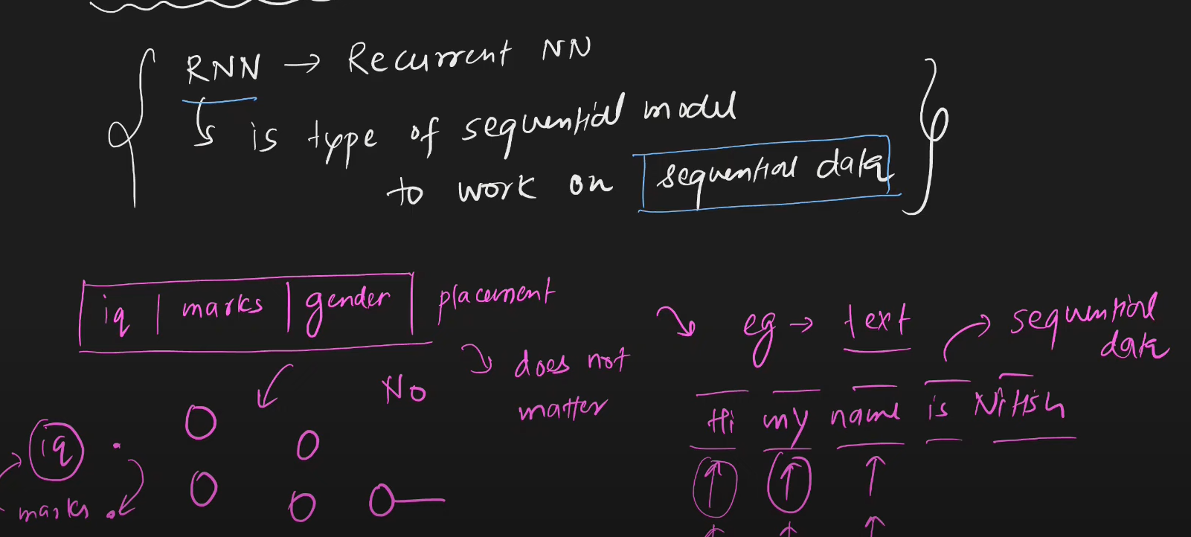
RNN IS well shuted for text
it is class of NN
which is use in LLM Models
RNN need for sequetialdata

Slide 8
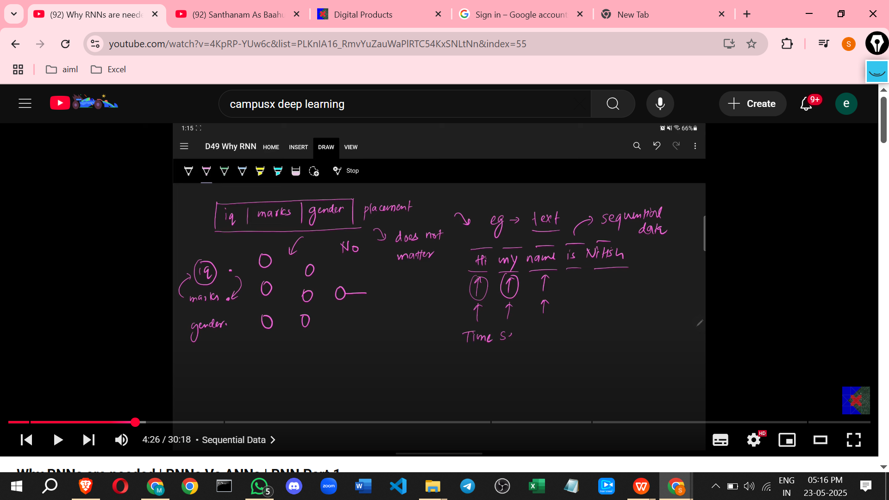

Slide 9
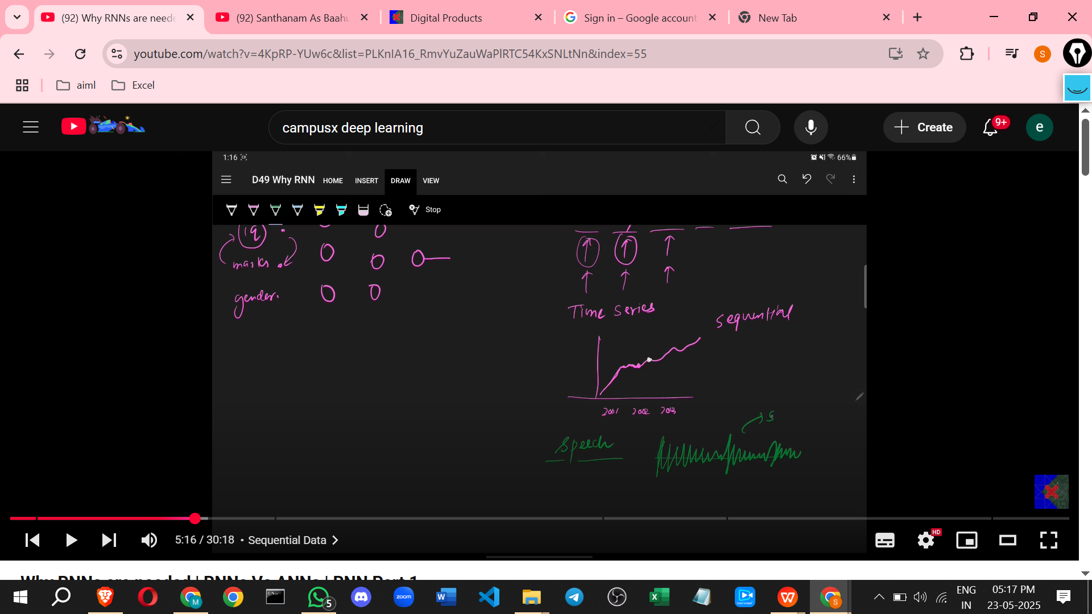

Slide 10
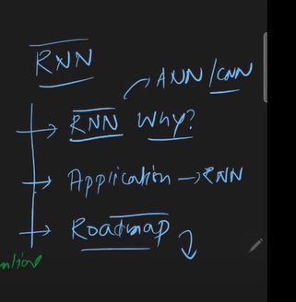

Slide 11
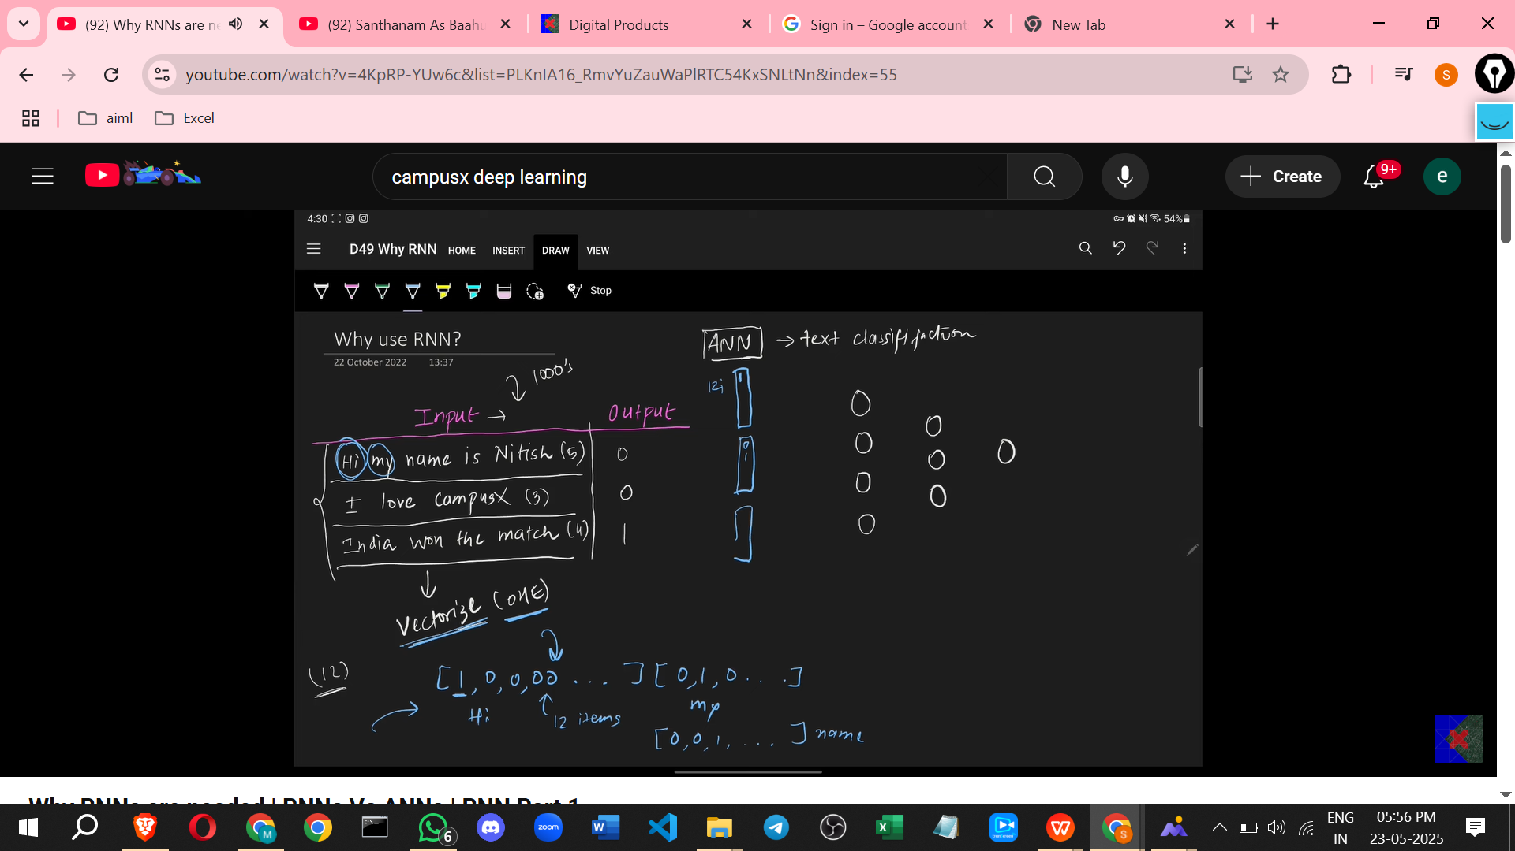

Slide 12
For 2ndsentence 3 words of 12OHE and in 1st

Slide 13
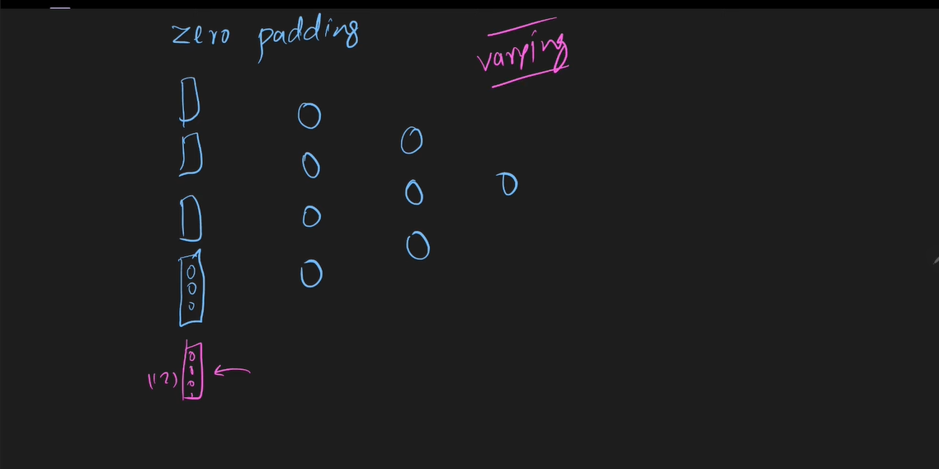
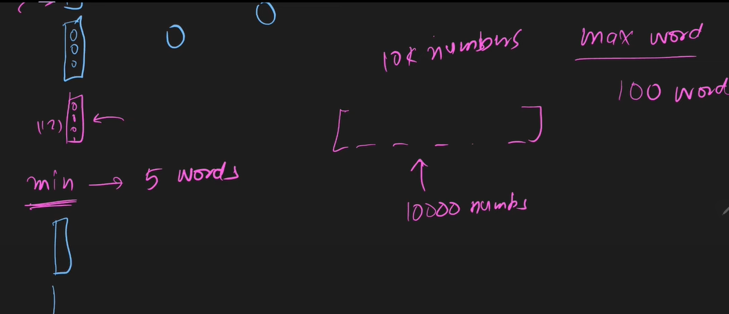

Slide 14
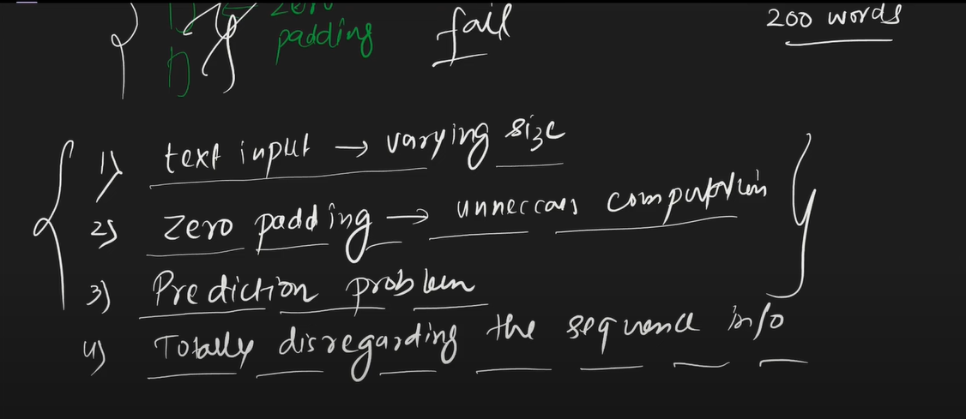
So now create a new archtecture for solve these problems

Slide 15
Recurrent Neural Network | Forward Propagation | Architecture

Slide 16
Here are detailed notes on Recurrent Neural Networks (RNNs) based on the provided sources:
Need for Recurrent Neural Networks (RNNs)
RNNs are necessary when dealing with sequential data.
Traditional neural network architectures like ANNs and CNNs do not work well with sequential data.
There are two main reasons why ANNs are not suitable for sequential data:
Variable Input Length: Sequential data can be of any length. ANNs generally work with fixed input sizes. For example, movie reviews have varying numbers of words, which is problematic for ANNs. Using ANNs with varying lengths would require defining a maximum length and padding, which leads to increased computation costs and is not logical.
Sequence Meaning: Sequences contain inherent meaning where later elements depend on earlier ones. Reading a sentence requires keeping previous words in mind to process the current word. ANNs process input all at once, losing the sequential information hidden within the data.
RNNs are a special class of neural networks with a memory feature, allowing them to remember past inputs. This makes them work well with sequential data.
Input Data Format for RNNs
Data is typically input into an RNN in the form of Time Steps × Input Features.
For problems like sentiment analysis of movie reviews, the input is a sequence of words.
To feed words into a machine learning model, they must be represented numerically, for example, using vectors.
If a vocabulary consists of 5 words (e.g., "movie", "is", "good", "bad", "not"), each word can be represented by a 5-number vector (e.g., one-hot encoding). This means the number of input features is 5.
A review like "movie is good" has 3 words. When processing this review with an RNN, you send one word at a time.
Sending the first word is referred to as Time = 1, the second word as Time = 2, and so on.
A review with 3 words will have 3 time steps.
Therefore, the shape of the input data for a single review with 3 words, where each word is represented by a 5-number vector, would be 3 (Time Steps) × 5 (Input Features).
When processing multiple reviews together in a batch, the data shape in the tf.keras.layers.SimpleRNN class would be Batch Size × Time Steps × Input Features. The Time Steps would be the maximum number of words in any review in the batch.
RNN Architecture and Differences from ANNs
An RNN architecture is very similar to an ANN but with two key differences.
Like an ANN, an RNN has an input layer, one or multiple hidden layers, and an output layer.
First difference: Unlike ANNs where the entire input is fed at once, in RNNs, the input is sent one by one based on time. For a movie review, you send the first word vector at T=1, then the second at T=2, and the third at T=3.
Second difference: ANNs are feed-forward neural networks, meaning information flows only from input to output. RNNs are not purely feed-forward; they have a concept of state. The hidden layer in an RNN sends a feedback connection back. This connection is the biggest difference and what makes an RNN an RNN.
Detailed Architecture Example (Sentiment Analysis)
Using the sentiment analysis example with a 5-word vocabulary, the input layer would have 5 nodes because each word is represented by 5 numbers.
The example architecture uses a hidden layer with 3 nodes. This number can be varied.
The connections between the input layer (5 nodes) and the hidden layer (3 nodes) are fully connected, similar to an ANN.
There is also an output layer. For binary sentiment analysis (positive/negative), the output layer has 1 node.
The activation function for the output layer in this binary classification case is Sigmoid. If it were multi-class classification, it would be Softmax; for regression, it could be Linear.
The crucial part is the recurrent connection from the hidden layer back to itself. The output of the hidden layer nodes at a given time step is fed back to the same hidden layer nodes for the next time step.
When processing the first time step (T=1), there is no previous output to feed back. In this case, a random input or often a zero vector (e.g., a 1x3 vector of zeros for a 3-node hidden layer) is used as the initial hidden state.
Weights and Parameters
In the example architecture with 5 input nodes and 3 hidden nodes:
Weights from input to hidden layer (W_ih or W_x) form a matrix of size 5x3.
There are also biases for the hidden layer nodes (b_h), a vector of size 1x3.
The recurrent connection from the hidden layer back to itself uses its own set of weights (W_hh or W_h). With 3 hidden nodes feeding back to 3 hidden nodes, this weight matrix is 3x3.
Weights from the hidden layer (3 nodes) to the output layer (1 node) (W_ho or W_y) form a matrix of size 3x1.
There is a bias for the output layer node (b_y), a scalar (1x1).
The total number of trainable parameters is the sum of weights and biases: (5x3) + (1x3) + (3x3) + (3x1) + (1x1) = 15 + 3 + 9 + 3 + 1 = 31 parameters. This matches the model summary shown.
Forward Propagation (Unfolding Through Time)
Forward propagation in RNNs follows a concept called unfolding through time.
The recurrent layer acts like a loop.
At Time = 1 (T=1):
The first word vector (X11 in the notation) is the input. It has a shape of 1x5.
This input (X11) is multiplied by the input-to-hidden weight matrix (W_x or W_ih).
A "previous output" (h0) from the hidden layer is also an input. Since this is the first step, h0 is typically initialised as a zero vector (e.g., 1x3 zeros).
h0 is multiplied by the hidden-to-hidden weight matrix (W_h or W_hh).
The results of both multiplications are added together.
This sum is then passed through an activation function (e.g., TanH, ReLU). This gives the output of the hidden layer at T=1 (let's call it h1).
This hidden output (h1) can then be used to calculate the final output for this time step.
h1 (shape 1x3) is multiplied by the hidden-to-output weight matrix (W_y or W_ho) (shape 3x1).
A bias for the output layer (b_y) is added.
This result is passed through the output activation function (Sigmoid in the example) to get the final output for T=1 (y1).
The hidden layer output h1 is also fed back as an input for the next time step (T=2).
At Time = 2 (T=2):
The second word vector (X12) is the current input.
The hidden output from the previous step (h1) is also an input.
X12 is multiplied by W_x.
h1 is multiplied by W_h.
These weighted inputs are added.
The sum goes through the hidden layer activation function to produce the current hidden output (h2).
h2 is used to calculate the final output for T=2 (y2) by multiplying with W_y, adding b_y, and applying the output activation.
h2 is fed back as input for the next step (T=3).
This process continues for all time steps (words in the review).
At the last time step (e.g., T=3 for a 3-word review), the hidden output (h3) is calculated based on the last word (X13) and the previous hidden output (h2).
The final output for the entire sequence is typically taken from the last time step's output (y3).
Note that in a simple RNN, you are reusing the same weights (W_x, W_h, W_y, b_h, b_y) across all time steps. This is called parameter sharing or weight sharing.
RNNs process the information from the sequence because the output at each step is influenced by the current input and the hidden state carried over from previous steps. The final output incorporates components from earlier steps' hidden outputs. A simple RNN can process information from roughly the previous 10 time steps.
Simplified Representation
An RNN can be imagined as a box that receives two inputs.
The first input is the current input (X_t) at time step t.
The second input is the hidden state from the previous time step (h_{t-1}).
Inside the box, the current input (X_t) is dot-producted with its weight matrix (W_x), and the previous hidden state (h_{t-1}) is dot-producted with its weight matrix (W_h).
These two results are added, along with the hidden layer bias (b_h).
This sum is then passed through a hidden layer activation function (e.g., TanH) to produce the current hidden state (h_t).
The current hidden state (h_t) is dot-producted with the output weight matrix (W_y), the output bias (b_y) is added, and this is passed through the output activation function (e.g., Sigmoid for binary classification) to get the final output for the current time step (y_t).
The current hidden state (h_t) becomes the previous hidden state for the next time step (h_{t-1} in the next cycle).
Next Steps
The next video will discuss backpropagation in RNNs.

Slide 17
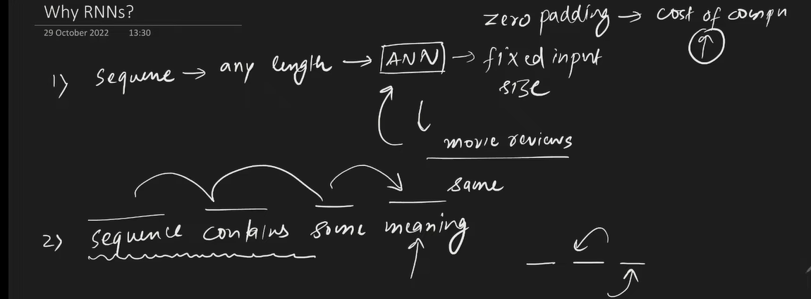

Slide 18
